Slide 1
Mini Project #3
File created on: 6/23/2025 11:34:20 AM

Slide 2
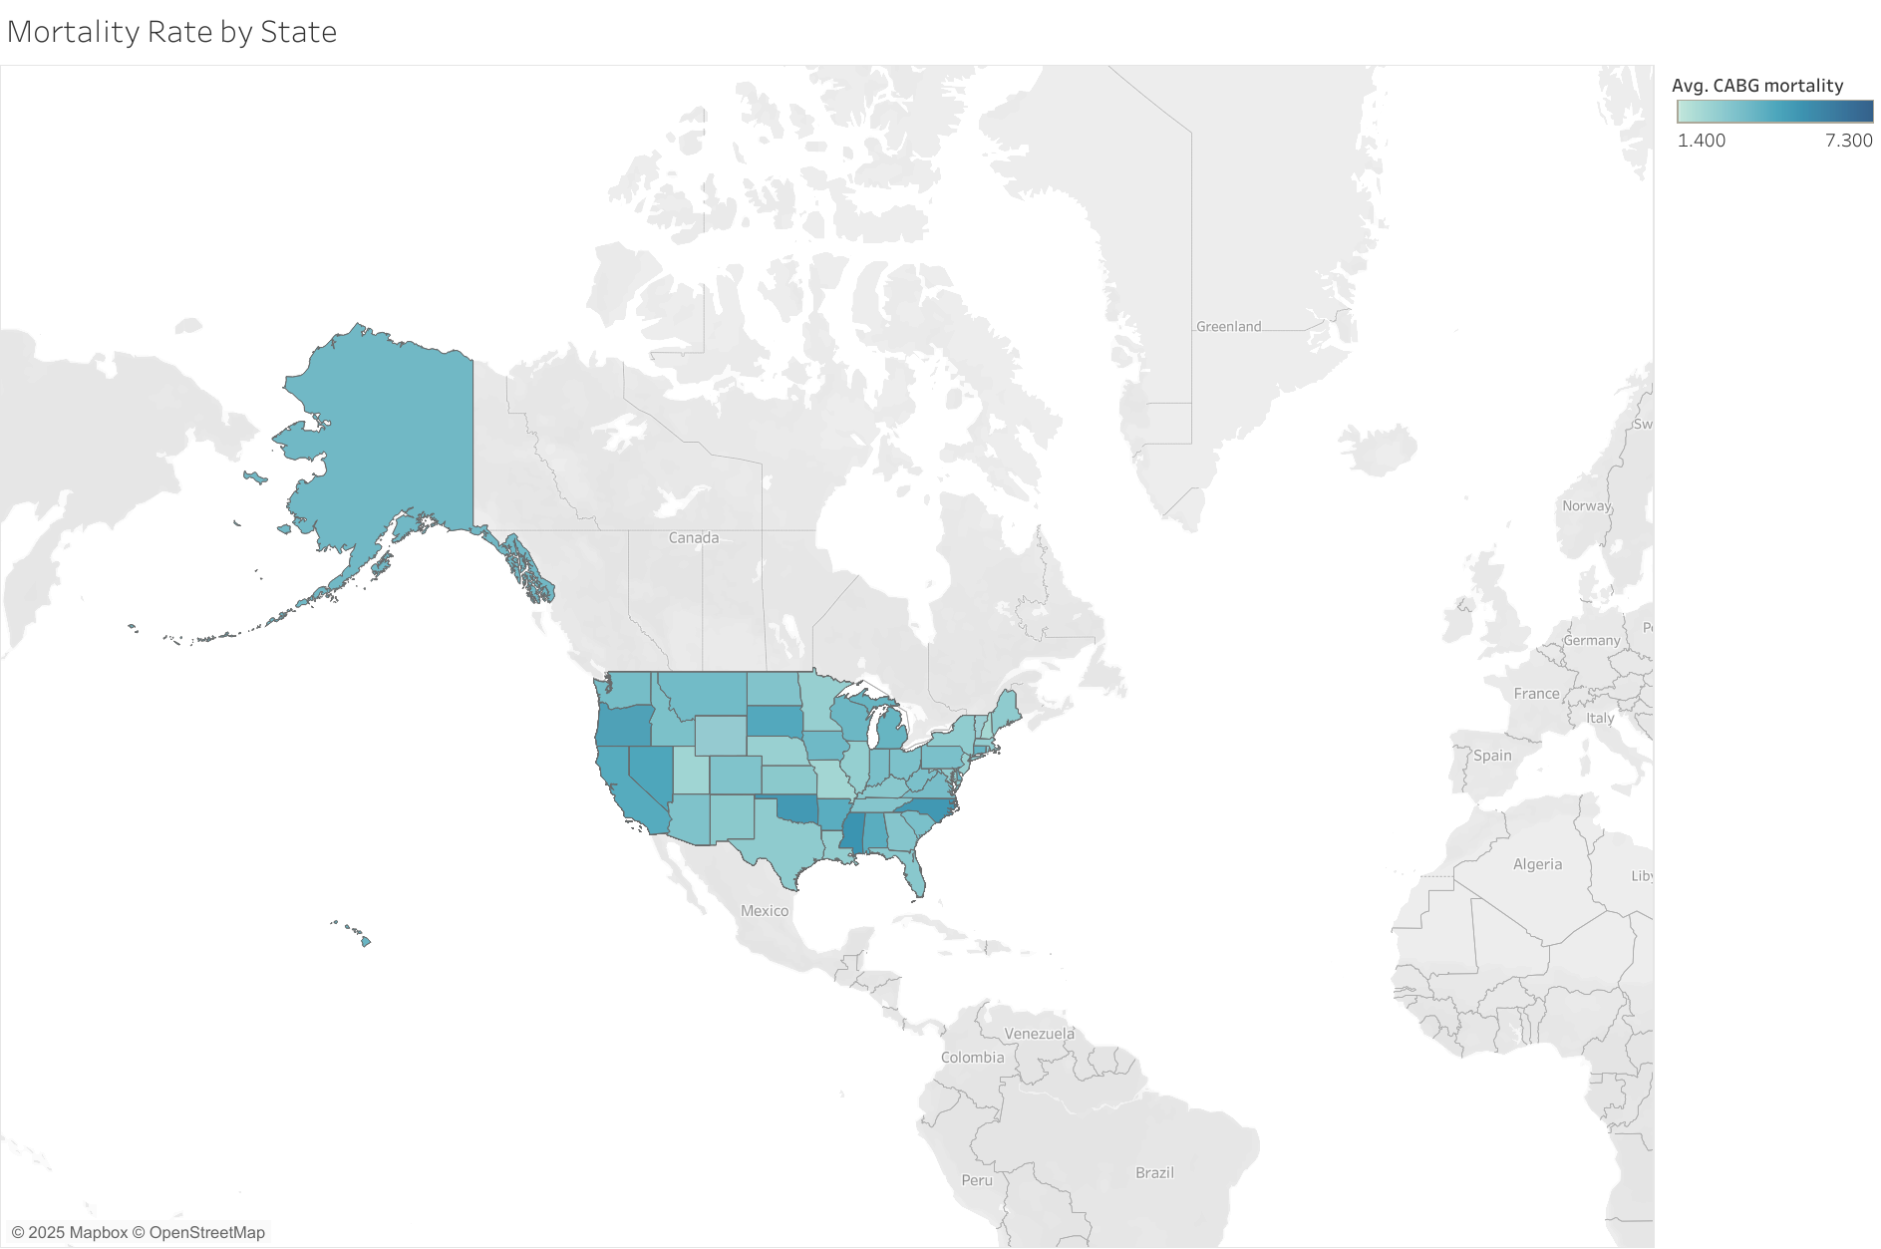

Slide 3
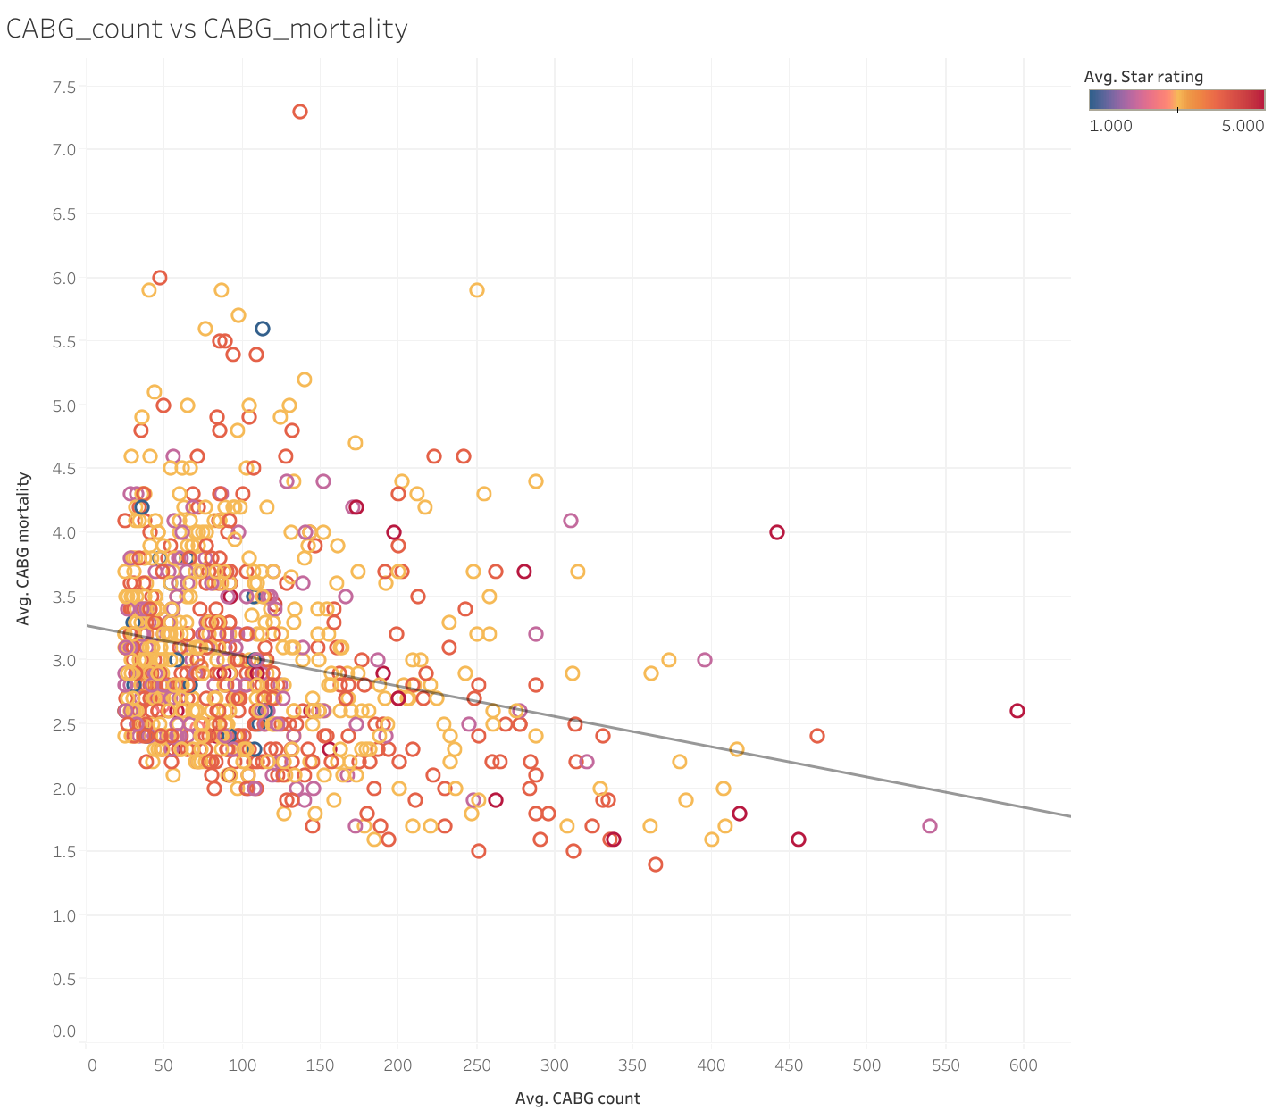

Slide 5
